Slide 1

Programming

Slide 2








Generations of Programming Language

Slide 3
What is a programming language?
English is a natural language. It has words symbols etc…
A programming language also has words, symbols and rules.
The rules are called as syntax.

Slide 4

Generations of Programming languages
Generations | Programming Language
First (1940-56) | Machine language
Second(1956-63) | Assembly language
Third(1964-71) | High-level language
Fourth(1971-Present) | Object oriented programming language
Fifth(Present and Beyond) | Artificial intelligence

Slide 5
Machine Languages(1940-56)
Machine language is a collection of binary digits or bits that the computers reads and interprets.it is a machine language.
It is almost impossible to understand for humans because they consist entirely of numbers.

Slide 6
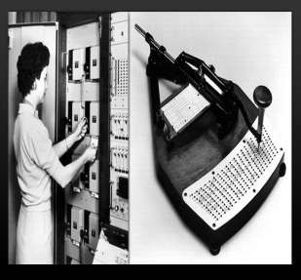
Disadvantages:
Difficult to remember machine instructions.
Difficult to understand, modify and debug errors.
It is not user-friendly language.
Each and every instruction must be in numerical.
The binary code is very difficult to learn and
use.
It is very complex and long winded programming.

Slide 7
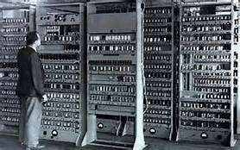
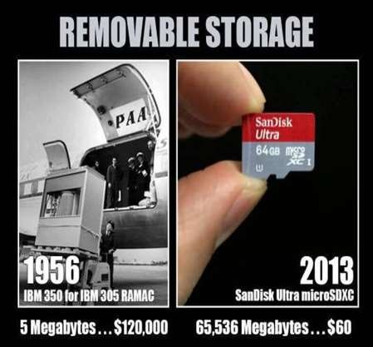
First generation computers:

Slide 8
Assembly language(1956-63)
Assembly language is just one level higher than machine language.it consists of simple codes.
Each statement in assembly language corresponds directly to a machine code understood by the microprocessor.
We need an “assembler” to translate the assembly language into machine language.

Slide 9
Disadvantages:
It is a low level language.
programs are very large and difficult to follow.
Many instructions required to achieve small task.
programs are machine dependent that they are not executed if the hardware is changed.

Slide 10
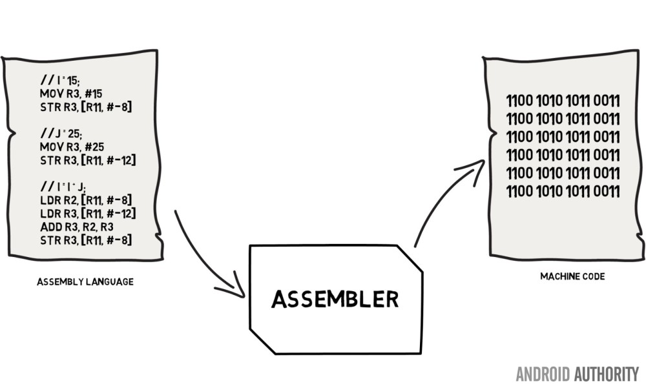
Flow of representation using assembly language:

Slide 11
High-level language(1964- 71)
A programming language that provides statements that are closer to the way the humans solve problems than assembly language.
Examples : COBAL , PASCAL , FORTRAN, C, C++ Etc…
The source code must be compiling by using ‘compiler’.

Slide 12
Advantages:
It is a user-friendly language.
These programs are machine independent.
If a program written from one computer we can also use by other computers.
They are easy to learn, easy to write and easy to remember.

Slide 13
Disadvantages:
The programs will take more time to run.
Slower than low-level language, for example
Assembler is faster than C.
Additional software i.e. compiler is needed in order to use a high-level- language.

Slide 14
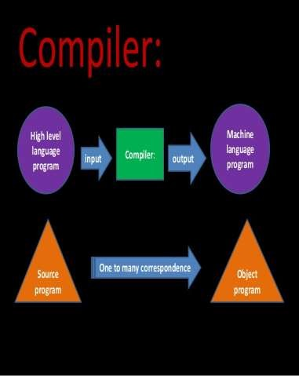
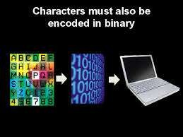
Flow of representation using high-level language:

Slide 15
Object oriented programming language(1971-Present)
Object : An object is software, bundle of related variables and methods.
OOP is a programming language which uses the objects and data structures consisting of data fields and methods. This includes the features such as data abstraction, encapsulation, data hiding, polymorphism and inheritance etc.
Examples: C++, Java, Python

Slide 16
Advantages:
It is a user-friendly language.
We can reuse and recycle the code.
Through the inheritance we can eliminate redundant code.
The principle of data hiding secures the
program.
We can extend the use of existing classes.
Software complexity can easily manage.

Slide 17
Disadvantages:
The oop programs are designed trickily.
To design an oop program we need to do proper planning and proper design.
To develop an oop program, programmer needs proper skills such as design skills, programming skills, technical skills etc.

Slide 18
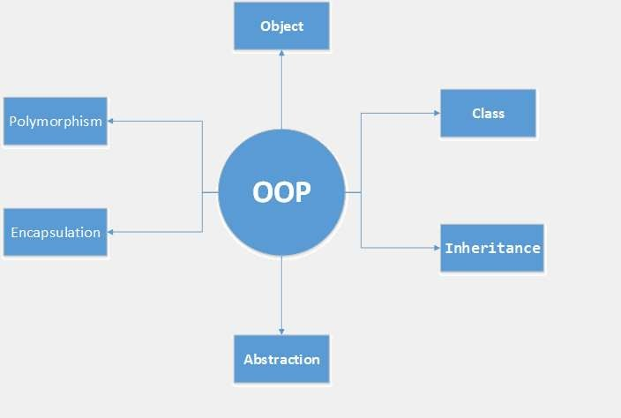
Flow of representation using oop language:

Slide 19
Artificial Intelligence(present and beyond)
A.I is a science of designing and programming computers to doing intelligent things and to simulate human thought process.
It is a high level language.
It is a logic language which is done by less programmer control.
We need expert systems.
Examples: Prolog.

Slide 20
Advantages:
They are more accurate and speed than the humans.
We can use this in dangerous environments.
We can access them 24/7. They don’t need sleep or any breaks.
It makes our life easy, safety and more productivity.
Duplication of them is very easy.

Slide 21
Disadvantages:
They required high standard of maintenance.
Its programming is very complex and it is very expensive to buy.
It doesn’t have common sense; it can understand only commands and not situations.

Slide 22


Artificial intelligence:

Slide 23
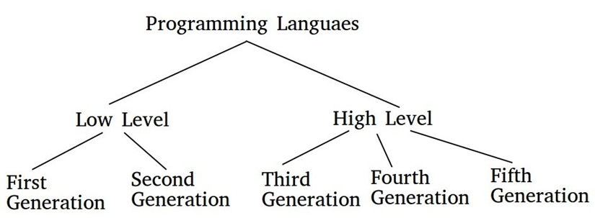
Reviews

Slide 24
Reviews
There are five generation of Programming languages. They are: First Generation Languages : These are low-level languages like machine language.
Second Generation Languages : These are low-level assembly languages used in kernels and hardware drives.
Third Generation Languages : These are high-level languages like C, C++, Java, Visual Basic and JavaScript.
Fourth Generation Languages : These are languages that consist of statements that are similar to statements in the human language. These are used mainly in database programming and scripting. Example of these languages include Perl, Python, Ruby, SQL, MatLab.
Fifth Generation Languages : These are the programming languages that have visual tools to develop a program. Examples of fifth generation language include Mercury, OPS5, and Prolog.
The first two generations are called low level languages. The next three generations are called high level languages.

